Slide 1
GODEX-NWP 2017
Nigel Atkinson, Met Office
16th – 19th May 2017, Lannion, France

Slide 2
Contents
NWP model and infrastructure capabilities
Changes in data usage since last GODEX-NWP (focussing on satellite data)
Report from RTH Exeter
WMO matters

Slide 3
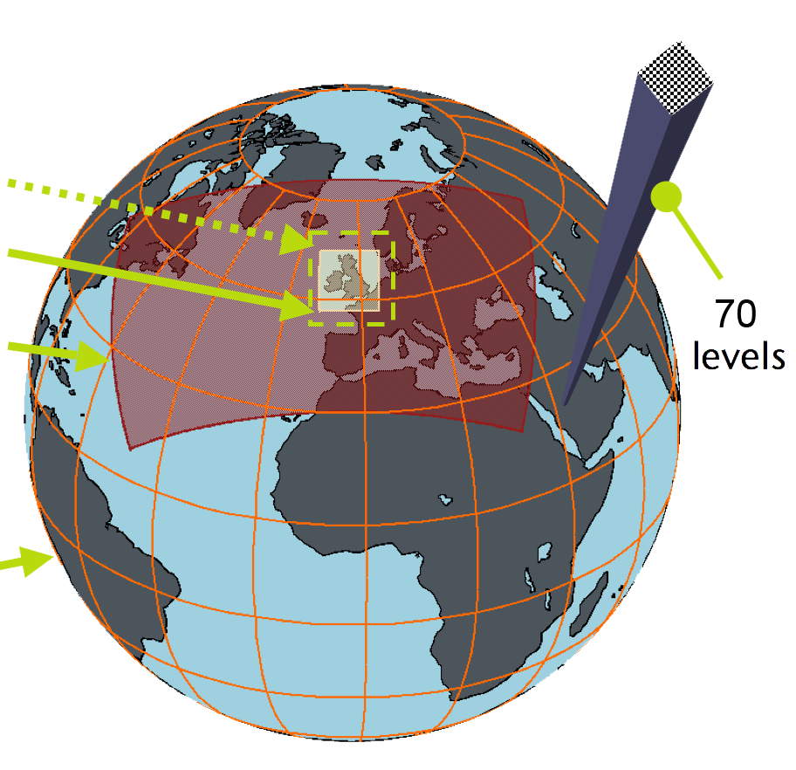
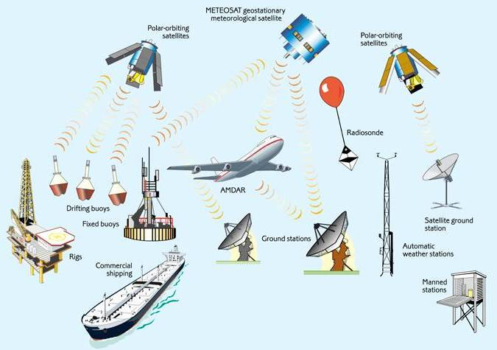
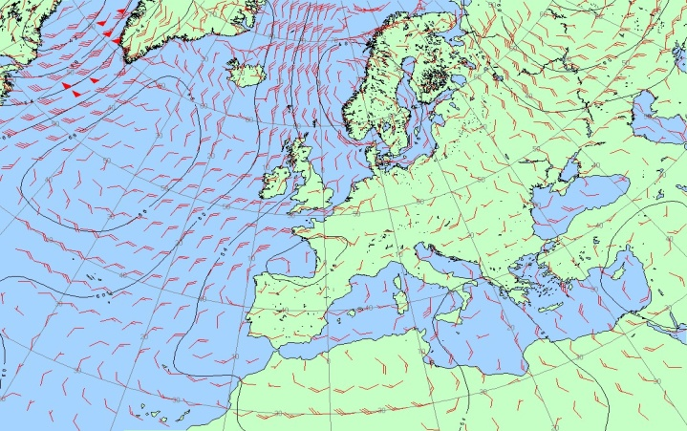
Forecasting Process
UK 1.5km
+UK ensemble
Regional 4km
+Regional ensemble
Observations
Global 17km
+Global ensemble

Slide 4
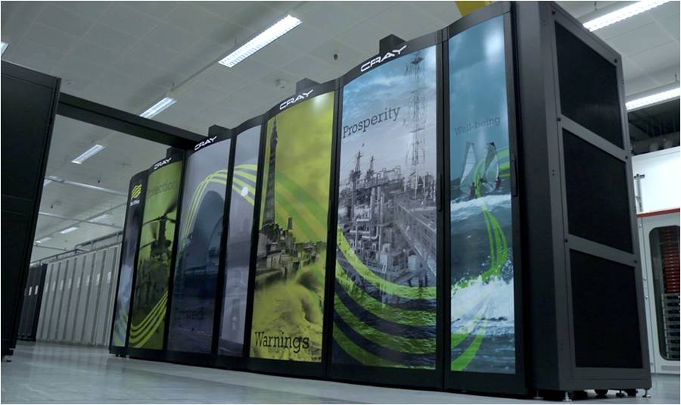
Supercomputer
Old
Systems in 3 computer halls (two at HQ and one in new building in Exeter Science Park)
Cost £97m
Delivered on time
Parallel Suite 37 was successfully implemented on 15th March 2016
Hall 3 system completed spring 2017
Hall 3

Slide 5
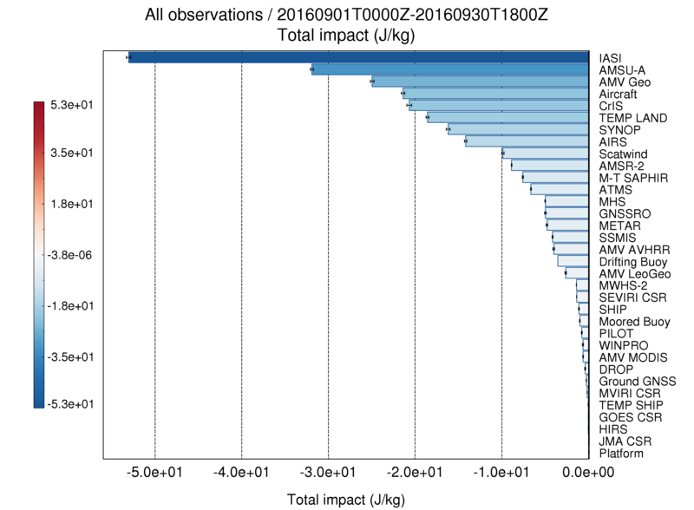
FSOI (operations, Sept 2016) “Forecast sensitivity to observation impact” = reduction in 24h forecast error due to each ob-type
*
*
New
obs added in 2016
*
*
*
*
*
*
*
*
*
* = non-satellite obs
Impact of satellite obs ≈75% of total impact

Slide 6
Satellite data used in NWP
Through data assimilation:
satellite sounder radiances - 3D temperature and humidity
AMVs, atmospheric motion vectors - geo and leo - winds
geo imager clear sky radiances - humidity
scatterometer – ocean surface wind vector
passive MW imagery – ocean surface wind speed
GPS - radio occultation - bending angles → density profile
GPS – total zenith delay - total column water vapour
geo imagery - cloud height and amount (UKV)
Also, various satellite data types for:
sea surface temperature
soil moisture
sea ice
snow cover

Slide 7
Satellite radiance data used pre-2016 in a 6h assimilation window
ATOVS=
AMSUA + MHS
AIRS
IASI
ATMS
CrIS

Slide 8
Satellite radiance data - updates post-PS37
in a 6h assimilation window
ATOVS=
AMSUA + MHS
AIRS
MT-Saphir
IASI
ATMS
MWHS-2
CrIS
AMSR-2
SSMIS

Slide 9
NWP Performance: Global upgrades 2015-16
PS35
(Feb 2015)
+0.9 (obs)
PS37
(Mar 2016)
+2.4 (obs) / +2.3 (anl)
PS38
(Nov 2016)
+1.0 (obs) / +1.6 (anl)
Improved RO operator
Correlated R for AIRS
CrIS over land
Improved radiance QC
VarBC
Correlated R for CrIS
SSMIS
AMSR-2
FY-3C MWHS-2
M-T Saphir
CVT
AIRS / CrIS (IR) dynamic land ɛ
AMSU-A (MW) dynamic land ɛ
Improved AMV QC
VIIRS winds
Himawari-8
Humidity radiance R-retune
FY-3B MWHS-1

Slide 10
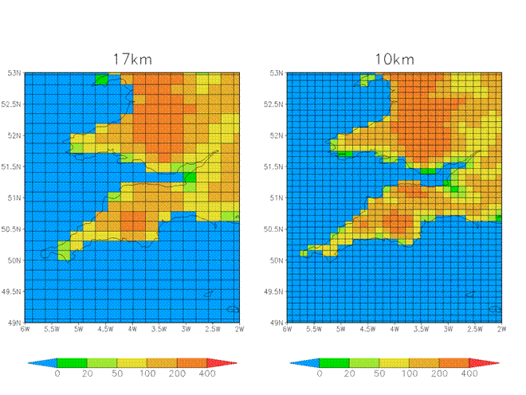
Spring 2017 – global model resolution upgrade

Slide 11
PS39 (June 2017): Global 10km Model (N1280)
Summer trial: +0.55 (obs), +0.59 (anal), +1.76% (UK Index)
Winter trial: +1.00 (obs), +1.45 (anal), +1.54% (UK Index):
Planning for June 2017 operational implementation.
Winter Verification Vs Obs
Winter Verif Vs Analysis

Slide 12
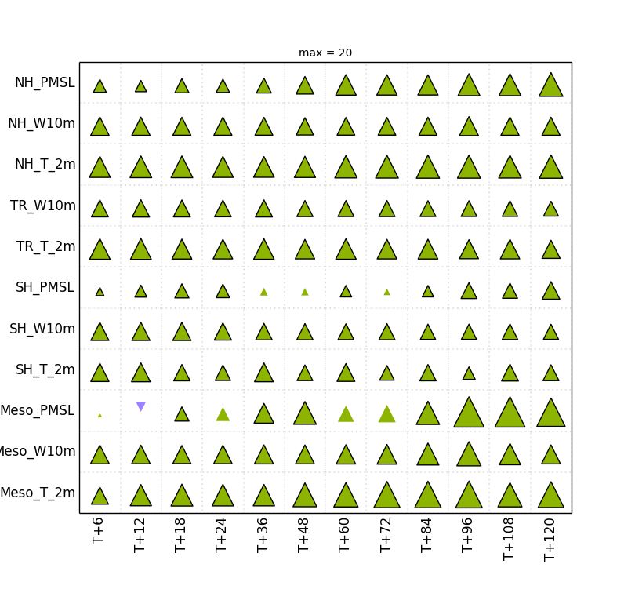
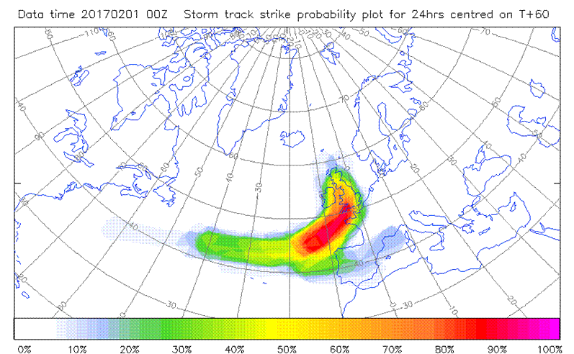
PS39: Global 20km Ensemble (N640)
Improved spread, lower ensemble mean RMSE, improved probabilistic scores (CRPS +3.5%)
PS39 EPS CRPS scorecard for winter 2016 – up is better (max
triangle = 20% improvement)
Improved ensemble skill can help provide better guidance for the probability of high-impact weather events such as a storm strike

Slide 13
PS39 UK model: Hourly 4DVar vs 3Hourly 3DVar, ‘Nowcasting’ Performance
Note: VarBC is used
Variable | Summer | Winter
Screen temperature | -12.4% | +0.9%
Screen relative humidity | -2.9% | -6.0%
Screen log₁₀ visibility | -2.4% | -4.0%
10-metre vector wind | -3.1% | -4.7%
pmsl | -3.2% | -10.0%
Total cloud cover | +3.8% | -2.1%
(Average of t+2 & t+8 rms errors for hourly 4DVAR –
Average of t+4 & t+10 rms errors for 3-hourly 3DVAR) /
Average of t+4 & t+10 rms errors for 3-hourly 3DVAR
Notes:
The main motivation for an hourly cycle is to run quickly with the latest observations and improve the forecast product available at a given time, rather than improve the product generated from a given data time. So when we assess the hourly cycle, we need to factor in the gain from earlier availability. This means in practice that for the 0-6 hour period of the current UKPP nowcasting system fed by 3-hourly UKV runs, the ‘forecast age’ of the NWP data used for blending can be either 3-9 hours, 4-10 hours or 5-11 hours, depending on the starting hour. With hourly NWP cycling, this should become 2-8 hours for every starting hour. This represents an average gain of 2 hours on the current situation. We have therefore compared the average of 3DVAR control rms errors at t+4 and t+10 with the same for the PS39 hourly 4DVAR package at t+2 and t+8, to derive the effective benefit of PS39 for nowcasting applications.

Slide 14
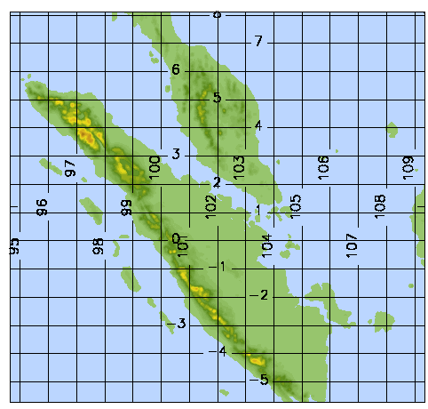
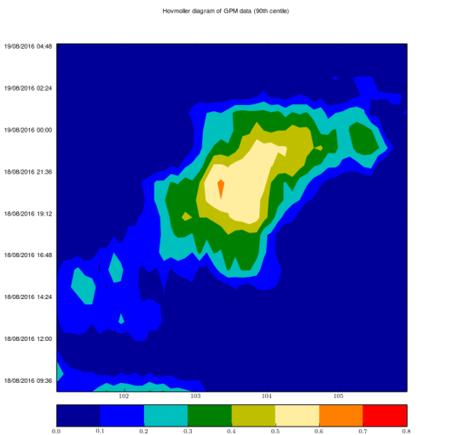
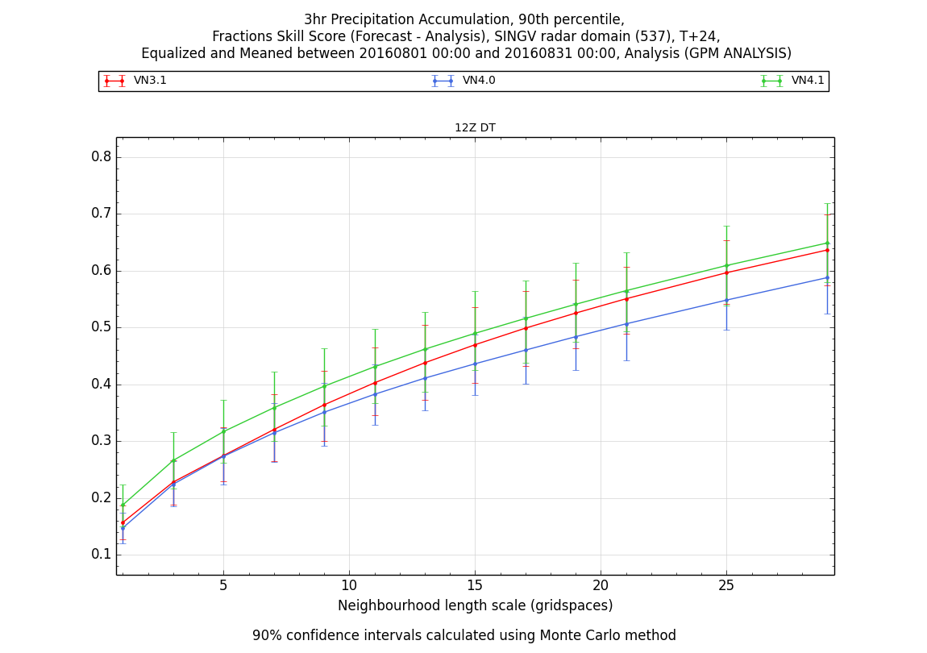
SINGV Project: Year 4
Implemented real-time DA and ensemble in Singapore
1st version of hourly 4DVar tested
Timely data over Singapore region is critical (making use of DBNet)
GPM:
SINGV 1.5km EPS: Hovmoller Plot:
VN3.1
VN4.0
VN4.1

Slide 15
Future satellites of particular interest
GOES-16
Now on EUMETCast (May 2017)
ADM-Aeolus
FY-4A
GIIRS (hyperspectral sounder) of particular interest – useful preparation for MTG-IRS
SRFs needed for GIIRS and AGRI
JPSS-1 – SRFs needed for VIIRS
FY-3D and 3E
Metop-SG-A1 (2021) and B1 (2022)
MTG-I1 (2021) and S1 (2022)

Slide 16
Where do we get meteorological data from?
EUMETCast
EUMETSAT
GTS
(national met. services)
Satellite direct broadcast
Met Office
NESDIS link
Satellite agencies e.g. NASA, ESA
Others
e.g. research organisations

Slide 17
What level of data do we need to handle?
Raw bit stream (e.g. direct broadcast)
Level 1b – raw counts with calibration coefs
Level 1c – brightness temperature, on original measurement grid
Level 1.5 – MSG channel data
Level 2 – meteorological products (e.g. SST), on original measurement grid
Level 3 – gridded products
Formats?
Bespoke binary
BUFR and GRIB
NetCDF4 / hdf5
NetCDF3
hdf-eos
HRIT (for MSG)
Others ….

Slide 18
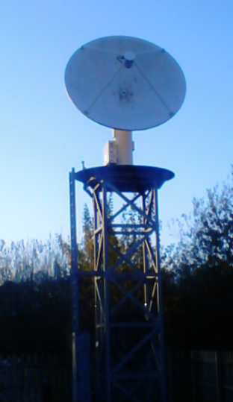
Direct broadcast reception
Still using two Spacetec (MEOS) systems on site at Exeter
NOAA-15/18/19, S-NPP, Metop-A/B, Terra, Aqua, FY-3A/3B/3C
Soon: JPSS-1, FY-3D
FY-3E is t.b.d. (polarisation issue)
Processing packages:
AAPP (NWP SAF)
CSPP (UW/NOAA)
FY3L0pp / FY3L1pp
Including MWRI capability introduced in April 2016
3.2m Yentai
2.4m Orbital

Slide 19
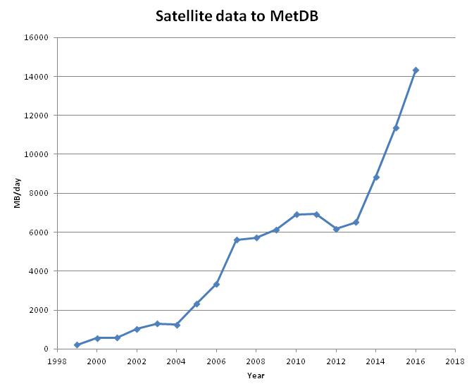
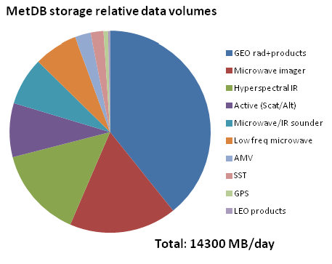
Storage in MetDB
Recently acquired 32TB disk, to ensure that most of this data is available on-line, reducing retrievals from MASS tape

Slide 20
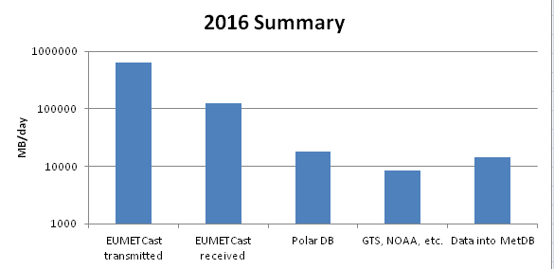
Relative volumes from different sources

Slide 21
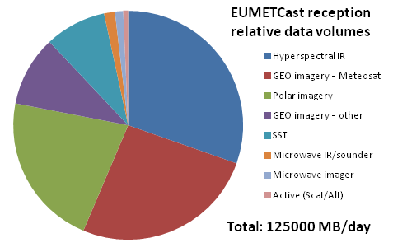
EUMETCast reception
Hyperspectral IR is the largest, though most of it is not stored (we use spectral and spatial thinning)

Slide 22
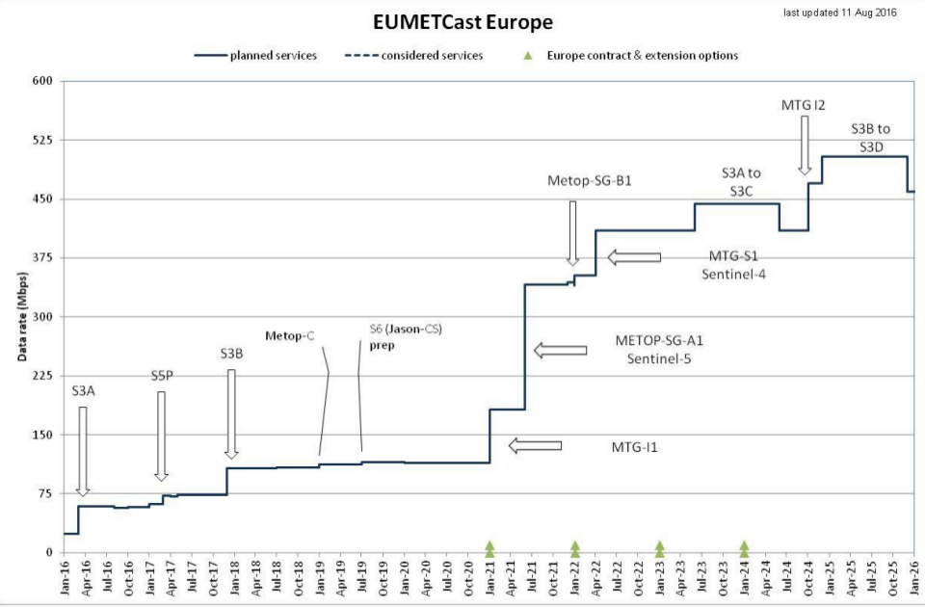
The challenge of data volume
We are here
Data transmitted on
EUMETCast
600GB/day
Chart from EUMETSAT
Massive increase from 2021 - be prepared!
Be selective over what we really need

Slide 23
NESDIS link
The Met Office still operates a direct link to NOAA/NESDIS
It has proved valuable on the rare occasions when NOAA internet links have been lost (e.g. in 2014)
Carries some data types that are not available by other means, including:
Aqua AIRS and AMSU-A global data (BUFR)
SSMIS UPP data (BUFR)
ATOVS level 1b (native format – useful for monitoring)
GOES CSR
We are considering whether a commercial link is still required, or whether we can rely on internet or some other solution
How robust is EUMETSAT’s link to NESDIS?

Slide 24
Report from RTH Exeter

Slide 25
RTH Exeter GTS connectivity
Connections to RTHs:
Brasilia, Melbourne, Moscow, New Delhi, Offenbach,
Pretoria, Rome, Tokyo, Toulouse, Washington
Connections to NMCs:
Brussels, Copenhagen, Dar es Salaam, De Bilt, Dublin,
Lisbon, Madrid, Montreal, Oslo, Reykjavik
Daily traffic:
Input 17 GBytes per day
Output 40 GBytes per day
99.98% availability between April 2015 and March 2017.

Slide 26
GISC Exeter WIS connectivity
Daily traffic statistics:
Ingesting 7.4GBytes of data into 24hr Cache.
Metadata catalog contains 155,000 records.
Daily catalog synchronisation with GISCs & DCPCs:
Beijing, Brasilia, ECMWF, Jeddah, Melbourne, Moscow,
Offenbach, Seoul, Tehran, Tokyo, Toulouse
97.59% availability between April 2015 and March 2017.
Data replication between 15 GISC’s may saturate network bandwidth.
Pilot project underway to test potential for cloud solution. Running for 18 months
Notes:
WIS is replacing the GTS. A GISC (global information systems centre) has a data cache containing 24 hours of essential data, plus a metadata catalogue describing data available from all national met centres.
The amount of data to be replicated between the GISCs may saturate current RMDCN connections, so a “data cache in the cloud” pilot is underway to test feasibility of using a data cache in the cloud to provide replication. Each GISC sends it’s data to the cloud, where it is available for all other GISCs.

Slide 27
Data migration away from traditional alphanumeric codes (TAC)
The Met Office has ceased to distribute land & SHIP SYNOP, CLIMAT and AMDAR data in TAC format, replacing them with BUFR format data.
So far, very few centres have ceased transmission of TAC format data. The main issues are:
Variable quality of conversion applications being used.
Differing interpretations of the various BUFR templates.
Poorly converted locations information.
Lack of funding to perform ‘grass roots’ data migration activity.
The Met Office is:
Contacting all recipients of TAC form data, to determine the impact of the change.
Providing links to a number of available converters that customers can use to convert TDCF data back to TAC.
The next conversion project is now underway, migrating aviation OPMET data to XML format – iWXXM.
Unlike TAC to BUFR, all non-Met Office OPMET data converted from XML back to TAC cannot be distributed outside of the organisation.
Stricter control on data will place onus on users of the OPMET data to migrate to using the XML formats.
Notes:
WMO is migrating many traditional alphanumeric code (TAC) formats to BUFR format. ICAO now migrating OPMET data from TAC to XML.
Met Office provides conversion of TAC to BUFR/XML and backward compatibility by converting BUFR/XML to TAC.

Slide 28
Present Data types on NESDIS Link
Data Type | Platform | File header | MB /day | Files
AMSU-A Level 1B | NOAA-ATOVS | nss.amax | 137 | 85
AMSU-B Level 1B | NOAA-ATOVS | nss.ambx | 97 | 14
HIRS Level 1B | NOAA-ATOVS | nss.hirx | 308 | 85
MHS Microwave Humidity Sounder | NOAA-ATOVS | nss.mhsx | 395 | 71
HIRS Level 1B (AVHRR mapped to HIRS grid) | NOAA-ATOVS | npr.atav | 118 | 57
AIRS Brightness temperatures | NASA –EOS-2 (Aqua) | npr.aibt | 166 | 242
AMSU-A Brightness temperatures | NASA –EOS-2 (Aqua) | npr.aubt | 9 | 232
SSM/I Brightness temperatures | DSMP | npr.sdrr | 72 | 14
SSMIS Level 1C | DSMP | npr.td{E,I,L,U}b | 900 | 208
SSMIS UPP | DSMP | npr.tdup | 318 | 35
Ozone, retrieved profiles and/or total column from SBUV | DSMP | prd.ozone.pmf | 3 | 14
WindSat |  | NPR_E068.WS | 0 | 0
COSMIC |  | bfrPrf_C00{1,2,4,5,6} | 2 | 185
CSBT |  | T_JUTX | 66 | 47
Total (wef 20 April 2017) |  |  | 2591 | 1289
Notes:
Overall decrease of about 1.5GByte per day since Sept 2015.
Decreases in traffic for:
SSMI/S level 1C & UPP

Slide 29
Present Data Volumes NESDIS Link

Slide 30
WMO matters

Slide 31
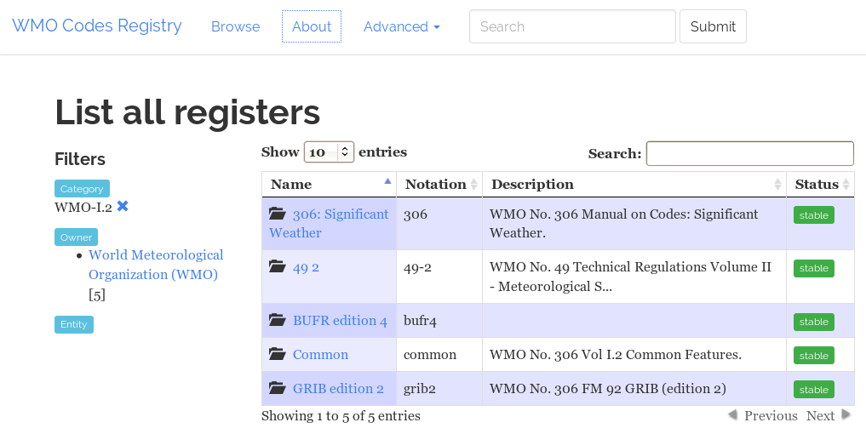
WMO codes registry (information from Mark Hedley)
http://codes.wmo.int
“The primary purpose of this Service is to support the new data exchange standard developed by WMO in support of Amendment 76 to ICAO Annex 3 "Meteorological Services for International Air Navigation”
The Met Office operates this Service on behalf of WMO.

Slide 32
WIGOS Station identifiers (information from Richard Weedon)
The WMO IPET-DRC (Inter-Programme Team on Data Representation and Codes) discussed the extension of the current system of station Identification in 2011.
In 2014 the ICG-WIGOS group reviewed and agreed upon the structure of the new identifier.
It was agreed at this time that the new system of identification would be restricted to table Driven Code Forms (BUFR & CREX). Representation of the new identifier within TAC would not be possible.
In the same year the IPET-DRMM were invited to construct new entries in TDCF tables B and D to represent the new structure .

Slide 33
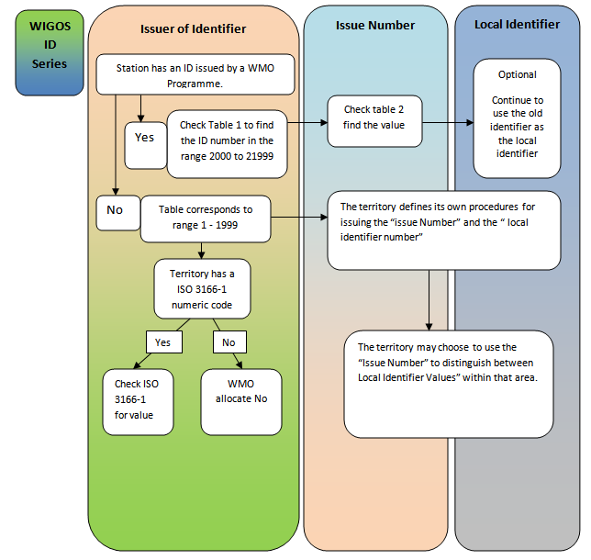
Assignment of a WIGOS ID
It’s complicated – lots of issues to be worked out
OSCAR/Surface needs to be used to identify stations
BUFR sequence 3-01-150 added to start of the sequence contains the identifier
Surface observations from existing WWW stations may or may not include the new identifiers
Examples:
Exeter airport = 0-20000-0-03839
Ship 9631369 = 0-20007-0-9631369
Jungfraujoch (JFJ) = 0-20008-0-JFJ
METEOSAT-10 (ID=57) = 0-20009-0-057

Slide 34
WIGOS ID - conclusions
The development of the WIGOS identification system, is still in its early stages. Its successful completion is dependent on the construction of national practices to govern the issuing of the ID’s.
The new system has a heavy reliance on OSCAR as a source of reference, which currently has a limited interface.
Not all data producers are in a position to produce BUFR for onwards transmission. This has placed a heavy workload on the regional centres and RTH’s who are expected to provide TAC to BUFR conversion
Data producers must agree upon a national practice which links the standard identification system with that used by the centre responsible for the conversion of the data to TDCF

Slide 35
Thank you! Questions?

